Slide 1

Distributed Systems
Unit 1 INTRODUCTION
Ling ZHOU
School of Computer Science and Engineering
College of Software Engineering,
Southeast University, Nanjing
ling.zhou@seu.edu.cn

Slide 2
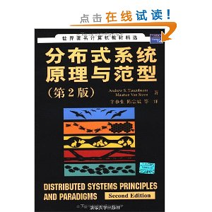
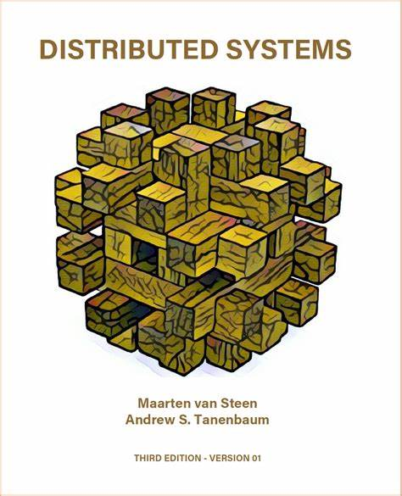
Reference Textbooks
Distributed Systems (3nd Edition)
Andrew S. Tanenbaum, Maarten Van Steen
Pearson Education, Inc.
December 2018
www.distributed-systems.net
分布式系统原理与范型(第2版)
Andrew S.Tanenbaum 等
辛春生、陈宗斌 等译
清华大学出版社 （2008年6月1日）
Notes:
It is a huge difference compared to the previous editions, the most important one
perhaps being that we have fully integrated the “principles” and “paradigms”

Slide 3
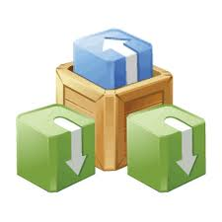
Course Content
Unit 1 – Introduction
Unit 2 – Architectures
Unit 3 – Processes
Unit 4 – Communication
Unit 5 – Naming
Unit 6 – Synchronization
Unit 7 – Consistency and replication
Unit 8 – Fault tolerance
Unit 9 – Security
Coordination

Slide 4

Unit 1 – Introduction: Outline
Brief history of modern computer era
What are distributed systems?
Goals of building distributed systems
Types of distributed systems
Summary

Slide 5
Brief History
1945 (modern computer era began) − 1985
− Computers were large and expensive
− Lack of a way to connect them
− Operated independently, i.e., CENTRALIZED SYSTEMS
Mid-1980s
− Powerful microprocessors (8-, 16-, 32-, 64-bit CPU)
− Much cheaper
− High speed computer networks (LANs , WANs)
DISTRIBUTED SYSTEMS

Slide 6
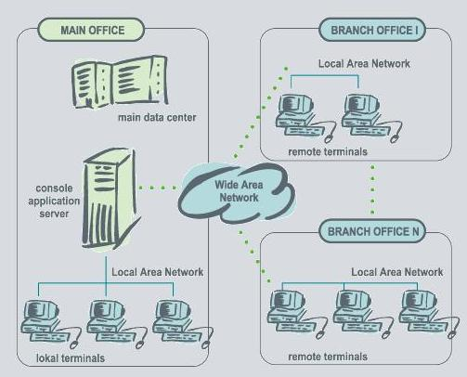
In Contrast to Centralized Systems
Centralized systems (or single-processor systems)
Consisting of a single computer, its peripherals, and perhaps some remote terminals

Slide 7
Centralized System vs. Distributed System
Criteria | Centralized system | Distributed system
Economics | Low | High
Availability | Low | High
Complexity | Low | High
Consistency | Simple | High
Scalability | Poor | Good
Technology | Homogeneous | Heterogeneous
Security | High | Low

Slide 8

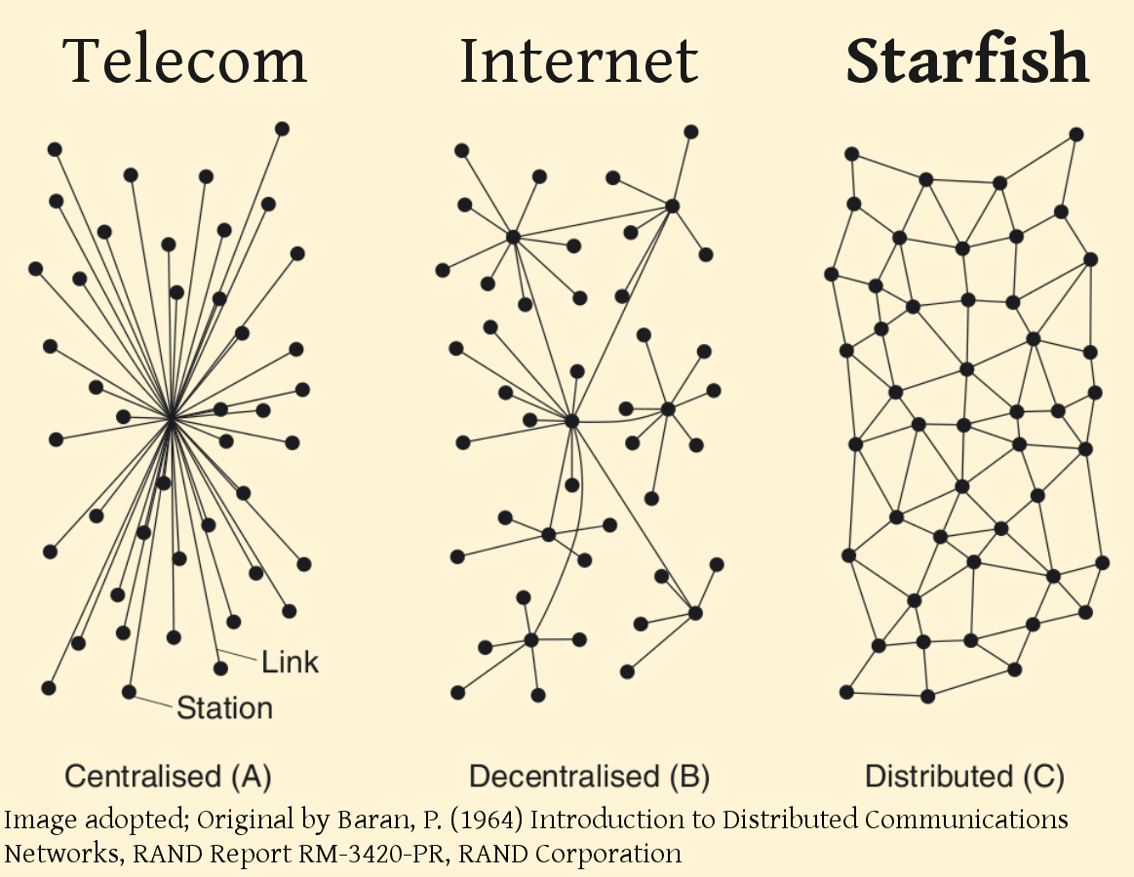
What are Distributed Systems (DS)?

Slide 9

Definition of A Distributed System -- A Loose Characterization
These so-called
nodes need
collaborate
A distributed system is
a collection of autonomous computing elements
that appears to its users as a single coherent system.
No assumptions are made
1) concerning the type of computers;
2) about how computers
are interconnected.
MIDDLEWARE

Slide 10

Characteristics of DS
Collection of autonomous nodes
Differences between the various computers and ways of communications are mostly hidden from users.
Coherent system
Users and applications can interact with a DS in a consistent and uniform way

Slide 11
Characteristics of DS (1) Collection of autonomous nodes
Independent behavior
Each autonomous node will have its own notion of time
There is NO global clock.
Leads to fundamental synchronization and coordination problems.
Collection of nodes
How to manage group membership?
How to know that you are indeed communicating with an authorized (non)member?

Slide 12
Characteristics of DS (1) Collection of autonomous nodes
Organization
Overlay network
Each node in the collection communicates only with other nodes in the system, its neighbors.
The set of neighbors may be dynamic, or may even be known only implicitly (i.e., requires a lookup).
Overlay types
Well-known example of overlay networks: peer-to-peer systems.
Structured: each node has a well-defined set of neighbors with whom it can communicate (tree, ring).
Unstructured: each node has references to randomly selected other nodes from the system.

Slide 13
Characteristics of DS (2) Coherent system
Essence
The collection of nodes as a whole operates the same, no matter where, when, and how interaction between a user and the system takes place.
Examples (distribution transparency)
An end user cannot tell where a computation is taking place
Where data is exactly stored should be irrelevant to an application
If or not data has been replicated is completely hidden
Partial failures
It is inevitable that at any time only a part of the distributed system fails.
Hiding partial failures and their recovery is often very difficult and in general impossible to hide.

Slide 14
Middleware: the OS of distributed systems
Computer 1
Computer 2
Computer 3
Computer 4
Appl. A
Appl. B
Appl. C
Distributed system layer (middleware)
Local OS 1
Local OS 2
Local OS 3
Local OS 4
Location: logically placed between a higher-level Appl. layer and a layer of OSs and basic communication facilities.
The middleware layer offers each application the same interface.
What does it contain?
Commonly used components and functions that need not be implemented by applications separately.
It hides the differences in hardware and OSs from each application.

Slide 15


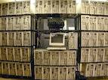
EXAMPLES
is the biggest example of DS
(information & resource sharing)
The Internet
Network File Systems
DNS (Domain Name System)
Massive multiprocessor supercomputers, e.g., Clusters, Network of workstations

Slide 16



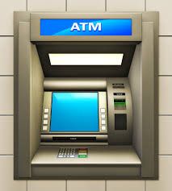
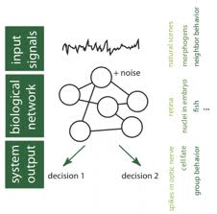
Application Fields
Banks
E-commerce
Computer games/PC games
Embedded systems
Biological information processing
Mobile equipment (e.g., PDAs, handy)
…

Slide 17

Economics
Speed
Inherent distribution
Reliability
Incremental growth
Complex software
Network
More components to fail
Security

Slide 18
Advantages of DS
Resource sharing
Sharing of hardware and software resources
Openness
Flexibility of using hardware and software of different vendors
Concurrency
Concurrent processing to enhance performance
Scalability
Increased throughput by adding new resources
Fault tolerance
The ability to continue in operation after a fault has occurred

Slide 19
Disadvantages of DS
Complexity
They are more complex than centralized systems
Security
More susceptible to external attack
Manageability
More effort required for system management
Unpredictability
Unpredictable responses depending on the system organization and network load

Slide 20
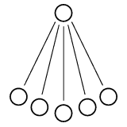
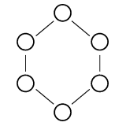
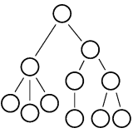
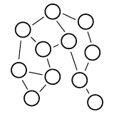
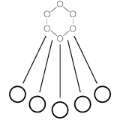
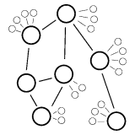
Distributed System Topologies
Four basic topologies
Hybrid systems
Topology | Centralized | Ring | Hierarchy | Decentralized | Centralized+ Ring | Centralized + Decentralized
Manageable | Yes | Yes | Partially | No | Yes | No
Coherent | Yes | Yes | Partially | No | Yes | Partially
Extensible | No | No | Partially | Yes | No | Yes
Fault-Tolerant | No | Yes | Partially | Yes | Yes | Yes
Secure | Yes | Yes | No | No | Yes | No
Lawsuit-Proof | No | No | No | Yes | No | Yes
Scalable | ? | Yes | Yes | Maybe | Yes | Apparently

Slide 21

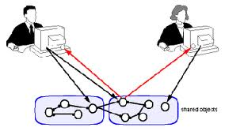
Goals of Distributed Systems
Making resources accessible
Distribution transparency
Openness
Scalability

Slide 22

Goal 1: Making Resources Accessible 
Reason of sharing is that of economics.
Aim: to make it easier for users/applications
- to access remote resources and to share them - to collaborate and exchange information, e.g., the Internet.
Resources: computers, storage facilities, printers, data, files, Web pages, and networks, etc.
Successful example: the connectivity of the Internet is leading to the cooperation of many virtual organizations
Problem: Security is becoming more important.

Slide 23

Sharing resources
Canonical examples
Cloud-based shared storage and files
Peer-to-peer assisted multimedia streaming
Shared mail services (think of outsourced mail systems)
Shared Web hosting (think of content distribution networks)
Observation
“The network is the computer”
(quote from John Gage, then at Sun Microsystems)

Slide 24

Goal 2: Distribution Transparency
What is transparency?
A distributed system that is able to present itself to users and applications as if it were only a single computer system is said to be transparent.
How to achieve the single-system image, i.e., how to make a collection of computers appear as a single computer?
Solution at two levels:
hide the distribution from users
at a lower level, make the system look transparent to programs.
a) and b) requires uniform interfaces such as access to files, communication.

Slide 25
Types of Transparency
Transparency | Description
Access | Hide differences in data representation and how an object is accessed
Location | Hide where an object is located
Migration | Hide that an object may move to another location
Relocation | Hide that an object may be moved to another location
Replication | Hide that an object is replicated
Concurrency | Hide that an object may be shared by several independent users
Failure | Hide the failure and recovery of a resource
Technology | Hides different technologies such as programming language and OS from users
Persistence | Hides whether a resource software is in memory or disk

Slide 26
Is Transparency Always Required?
Generally considered preferable for any DS
Hiding all distribution aspects is NOT a good idea
Example: communication latencies cannot be hidden
1. E-newspapers, sent punctually in the morning according to your local time, may come in the evening, due to global time difference.
2. Process communication in WAN-DS takes several hundreds of ms.
- Signal transmission is limited by the speed of light + by processing capacities of the intermediate switches
3. Replicas, located on different continents, may need seconds to complete update operation.

Slide 27


Degree of Transparency
Recognizing that full distribution transparency is simply (theoretically and practically) impossible E.g., time difference, signal transmission delay
Completely hiding distribution may cost performance. E.g., a) sending a print job to a printer in a different country; b) attempting to mask a transient server failure may cause repeated application contact.
Distribution exposure - sometimes better than hiding (example?)
- become more evident in embedded and ubiquitous distributed systems

Slide 28



Exposing distribution may be good
Making use of location-based services (finding your nearby friends)
When dealing with users in different time zones
When it makes it easier for a user to understand what’s going on
when e.g., a server does not respond for a long time, report it as failing

Slide 29
Goal 3: Openness 
An open distributed system offers services specified through interfaces (described in IDL) according to standard rules (formalized in protocols), irrespective of the underlying environment:
Complete and neutral specifications of the interface
Supporting interoperability and portability in different environment (e.g., different OS)
Easy for configuration out of different components
Extensible (easy to add/replace components)

Slide 30

Implementing Openness
Achieving flexibility an open DS is organized as a collection of relatively small components which are easily replaceable/adaptable
Separating policy from mechanism
Policy: a statement of what is, and is not allowed.
Mechanism: a procedure, tool, or method of enforcing a policy.
Notes:
E.g., web caching. - A user can implement his own policy in the form of a component that can be plugged into the browser.
- A rich set of parameters need to be offered which can be dynamically set by users.

Slide 31


Policies versus mechanisms
Implementing openness: policies
What level of consistency do we require for client-cached data?
Which operations do we allow downloaded code to perform?
Which QoS requirements do we adjust in the face of varying bandwidth?
What level of secrecy do we require for communication?
Implement openness: mechanisms
Allow (dynamic) setting of caching policies
Support different levels of trust for mobile code
Provide adjustable QoS parameters per data stream
Offer different encryption algorithms

Slide 32


On strict separation
Observation
The stricter the separation between policy and mechanism, the more we need to make ensure proper mechanisms, potentially leading to many configuration parameters and complex management.
Finding a balance
Hard coding policies often simplifies management and reduces complexity at the price of less flexibility. There is no obvious solution.

Slide 33
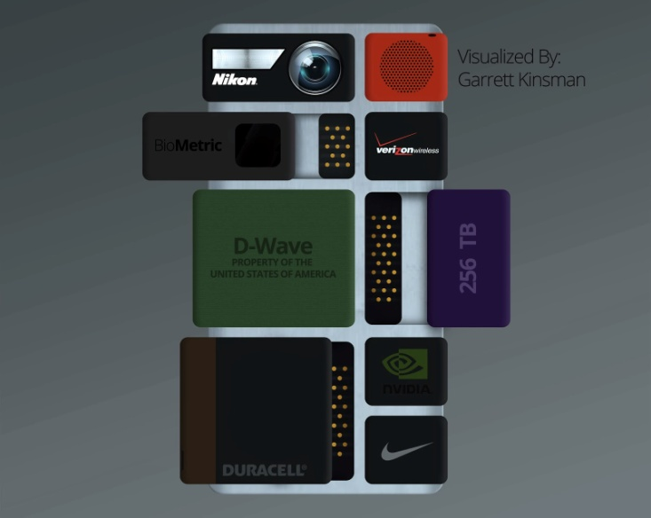
Replaceable Example: Google Project Ara Modular Smartphone
Project Ara – Part of it
http://v.youku.com/v_show/id_XODcyMTkxODM2.html
However, Google project ara was cancelled in Sept. 2016.
http://thenextweb.com/gadgets/2016/09/04/lets-just-admit-googles-project-ara-terrible-idea-move/#gref

Slide 34

About Monolithic Systems
Many older and even contemporary systems are constructed using a monolithic approach
In this system, components are only logically separated but implemented as one, huge program.
The monolithic approach makes it hard to replace or adapt a component without affecting the entire system
Does a monolithic system
tend to be closed or open?

Slide 35


Goal 4: Scalability
What kind of a system is scalable?
How can we measure the scalability of a system?
Along at least three dimensions:
Size scalability
Geographical scalability
Administrative scalability
As a system
scales up, it often exhibits loss of performance, in most cases due to limited capacity of servers and network.

Slide 36
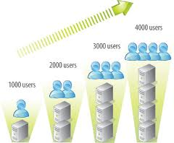
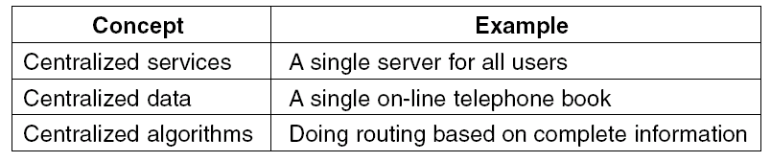
Size Scalability Problems
Limitations of centralized services, data, and algorithms
Using only a single server is sometimes unavoidable (example?), which can finally become a bottleneck.
Decentralized algorithms are preferred.
Table: Examples of scalability limitations

Slide 37
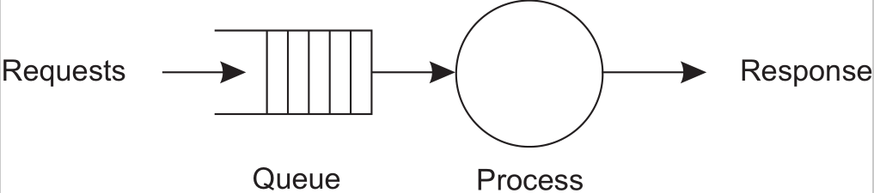
Size scalability
Root causes for scalability problems with centralized solutions
The computational capacity, limited by the CPUs
The storage capacity, including the transfer rate between CPUs and disks
The network between the user and the centralized service
A centralized service can be modeled as a simple queuing system

Slide 38

Geographical Scalability Problems
Existing DS were designed for LAN which are based on synchronous communication.
A client, when requesting service, blocks until it receives a reply
Takes at worst a few μs (10⁻⁶ s)
Highly reliable communication can be based on broadcasting
What would happen in WAN?
Interprocess communication may need hundreds of ms (10⁻³ s)
Three orders of magnitude slower
Inherently unreliable and virtually always P2P
Strongly related to the problem of centralized solutions
Conclusion: Building DS in WAN is difficult

Slide 39



Administrative Scalability Problems
Major problem:
Conflicting policies with respect to resource usage, payment, management and security

Slide 40

Administrative Scalability Problems
Examples
Computational grids: share expensive resources between different domains.
Shared equipment: how to control, manage, and use a shared radio telescope constructed as large-scale shared sensor network?
Exception: several peer-to-peer networks
File-sharing systems (based, e.g., on BitTorrent)
Peer-to-peer telephony (Skype)
Peer-assisted audio streaming (Spotify)
Note: end users collaborate and not administrative entities.

Slide 41


Scaling Techniques
Scalability problems in DS → performance problem caused by limited capacity of servers and network
Basically only three techniques for scaling
Hiding communication latencies
Distribution
Replication

Slide 42

Scaling Techniques (1): Hiding Latencies
Sol. 1: using asynchronous communication,
e.g., an alternative to waiting for a reply from the server is to do other useful work at the requester’s side
Sol. 2: reducing the overall communication,
e.g., moving part of the computation that is normally done at the server to the client process
The approach of shipping code is now widely supported by the Web in the form of Java applets and Javascript

Slide 43
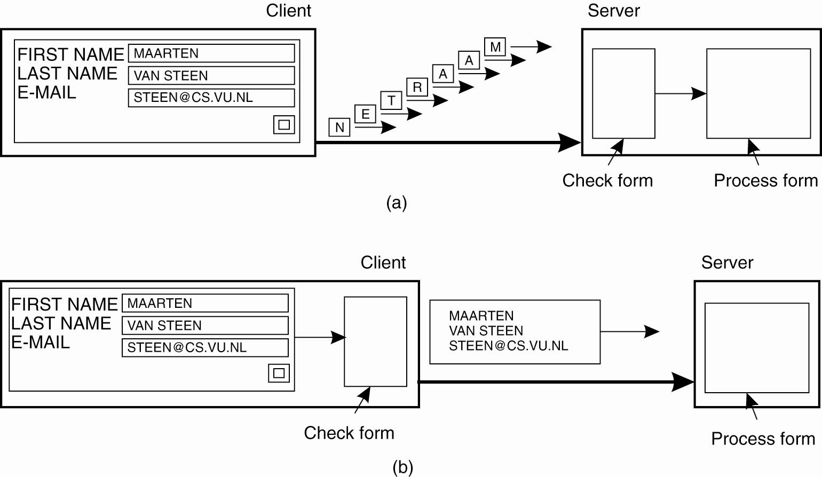
Figure: The difference between letting (a) a server or (b) a client check forms as they are being filled.

Slide 44
Scaling Techniques (2): Distribution
Partition data and computations across multiple machines
Move computations to clients (Java applets)
Decentralized naming services (DNS)
Decentralized information systems (WWW)

Slide 45
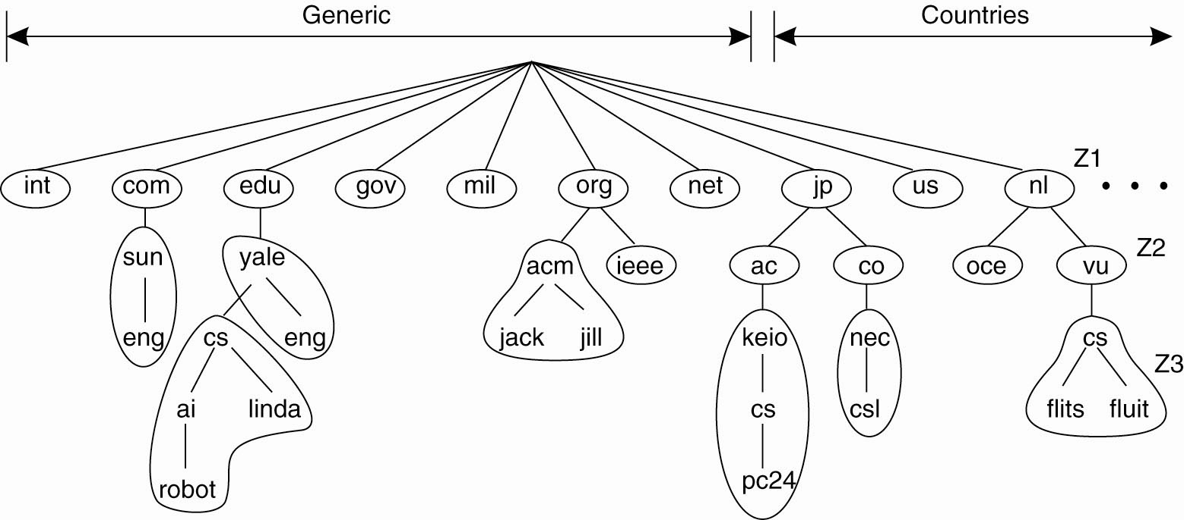
Figure: An example of dividing the DNS name space into zones.

Slide 46
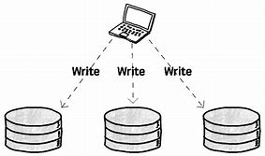
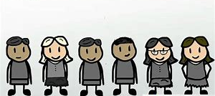
Scaling Techniques (3) Replication
Replication and caching: Make copies of data available at different machines
Replicated file servers and databases
Mirrored Web sites
Web caches (in browsers and proxies)
File caching (at server and client)

Slide 47
Scaling Techniques (3) Replication
Advantages:
Increases availability
Helps to balance the load between components leading to better performance
Having a copy nearby can hide much of communication latency problems
Caching is a special form of replication
A drawback to caching and replication that may adversely affect scalability and introduce other nonscalable solution:
E.g., leads to inconsistency

Slide 48
Summary of Scalability Solutions
Size scalability problem
In many cases, increasing the capacity of a machine
Geographical scalability problem
Distribution, replication and caching with different forms of consistency
Administrative scalability problem
Involving nontechnical problems
Peer-to-peer technology can be a partial solution
More difficult

Slide 49

(Unique) Pitfalls when Developing Distributed Systems
False (and often hidden) assumptions:
The network is reliable.
The network is secure.
The network is homogeneous.
The topology does not change.
Latency is zero.
Bandwidth is infinite.
Transport cost is zero.
There is one administrator.

Slide 50
Types of Distributed Systems
Cluster computing
Distributed computing systems
For high-performance computing tasks
Grid computing
Transaction processing systems
Distributed information systems
For information processing
Enterprise application integration
Home systems
Distributed pervasive / embedded systems
Electronic health care systems
For pervasiveness
Sensor networks
……

Slide 51

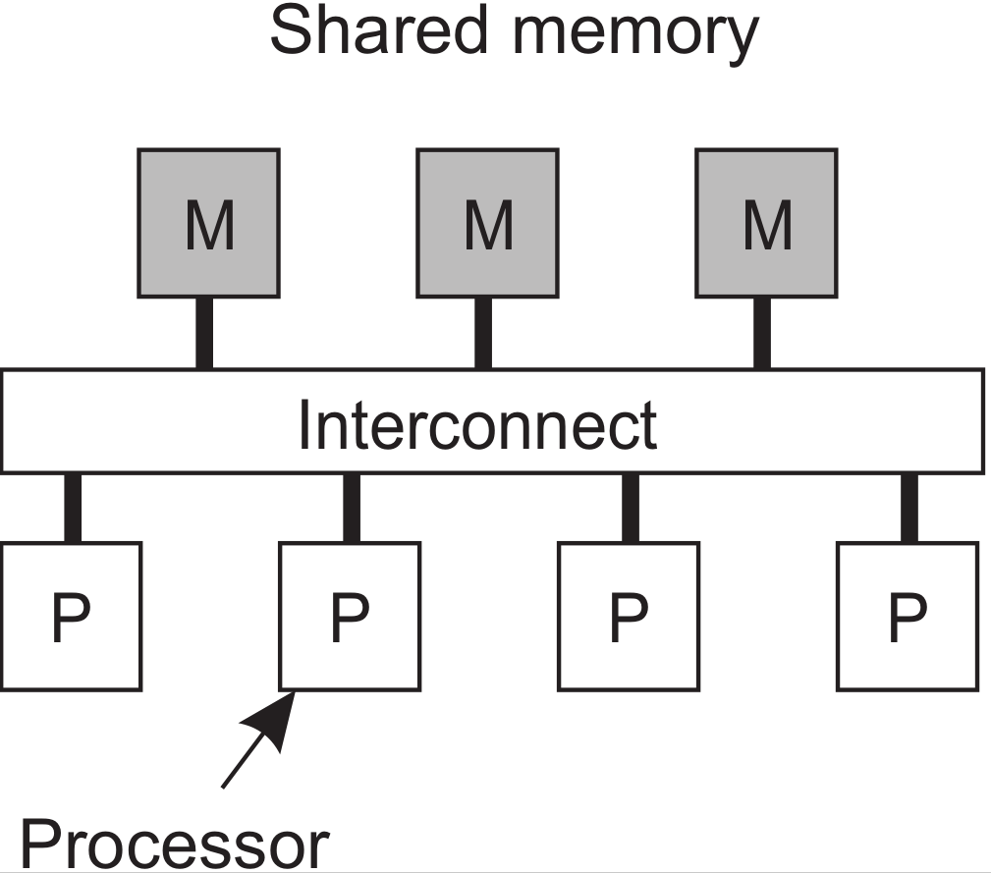
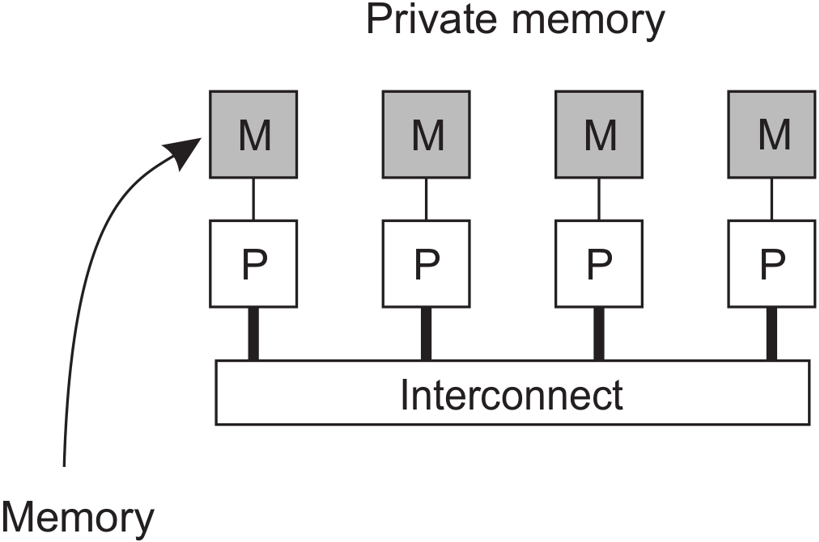
High performance distributed computing
Observation
High-performance distributed computing started with parallel computing
Multiprocessor and multicore versus multicomputer

Slide 52
Distributed shared memory systems
Observation
Multiprocessors are relatively easy to program in comparison to multi-computers
yet have problems when increasing the number of processors (or cores).
Solution: Try to implement a shared-memory model on top of a multicomputer.
Example through virtual-memory techniques
Problem
Performance of distributed shared memory could never compete with that of multiprocessors, failed to meet the expectations of programmers.
It has been widely abandoned by now.
Notes:
Example through virtual-memory techniques
Map all main-memory pages (from different processors) into one single virtual
address space. If process at processor A addresses a page P located at
processor B, the OS at A traps and fetches P from B, just as it would if P had
been located on local disk.

Slide 53
Distributed Computing Systems
 | Cluster computing | Grid computing
Characteristics | Homogeneity | Heterogeneity
Hardware | Similar | Can be different
Network | Centralized location/LAN | LAN/WAN/Internet
Operating system | Identical | Can be different
Administrative domain | The same | Can be different
Cost | Higher | More cost-effective
Note:
In virtually all cases, cluster computing is used for parallel programming.
To allow for collaborations, grids generally use virtual organizations (VO). The people belonging to the same virtual organization have access rights to the resources that are provided to that organization.

Slide 54
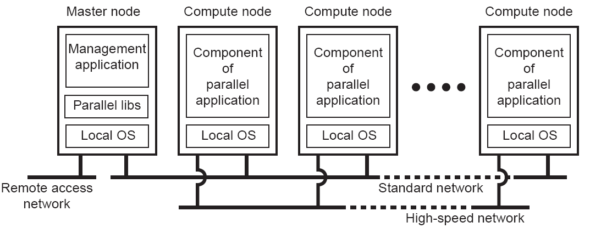
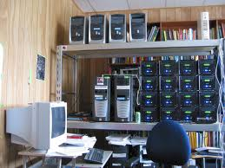
Cluster Computing Systems
Middleware
Essentially a group of high-end systems connected through a LAN
Homogeneous: same OS, near-identical hardware
Single managing node
Cluster building a super-computer becomes financially and technically attractive

Slide 55
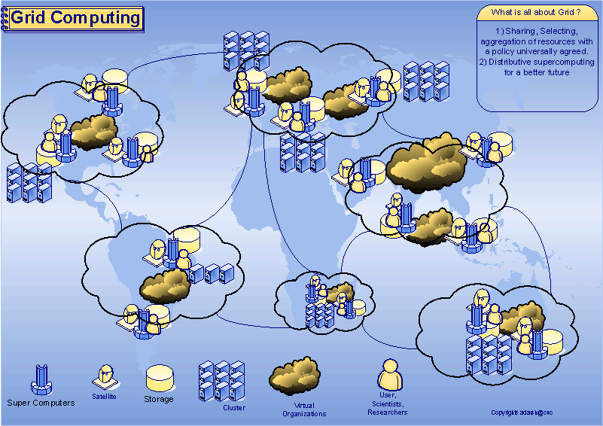
Grid Computing Systems

Slide 56
Grid Computing Systems
lots of nodes from everywhere
Heterogeneous
Dispersed across several organizations
Can easily span a wide-area network
Note
To allow for collaborations, grids generally use virtual organizations.
In essence, this is a grouping of users (or better: their IDs) that will allow for authorization on resource allocation.

Slide 57
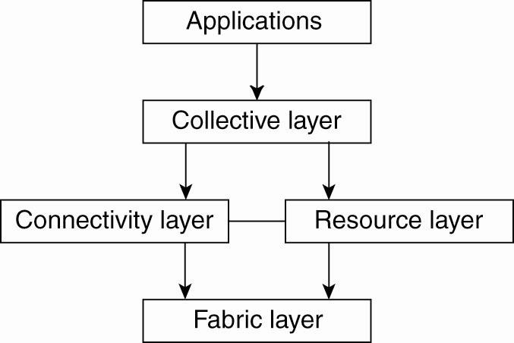
Grid Computing Systems: A layered architecture (Foster et al. 2001)
Consists of appl. that operate within a single VO
Handles access to multiple resources (resources discovery, allocation and scheduling …)
A grid middleware layer
Responsible for managing a single resource (access control)
Consists of communication protocols + security protocols (authentication)
Provides interfaces to local resources (query + management) at a specific site (within a VO)

Slide 58
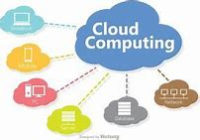
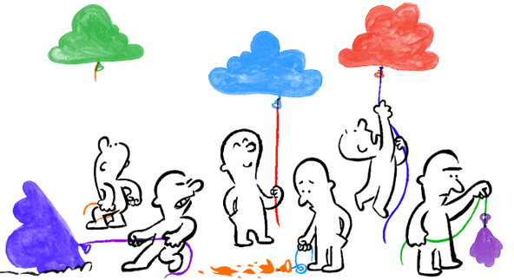
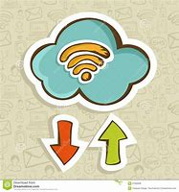
Cloud computing
Observation
An important reason for the success of cloud computing is that it allows organizations to outsource their IT infrastructure: hardware and software.
Essential question: is outsourcing also cheaper?

Slide 59
Types of Distributed Systems
Cluster computing
Distributed computing systems
For high-performance computing tasks
Grid computing
Transaction processing systems
Distributed information systems
For information processing
Enterprise application integration
Home systems
Distributed pervasive / embedded systems
Electronic health care systems
For pervasiveness
Sensor networks
……

Slide 60
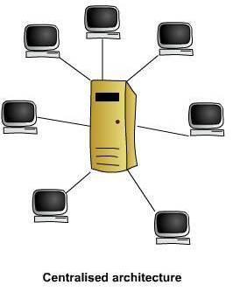
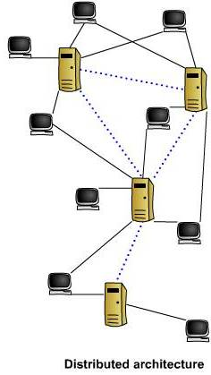
Comparison Between a Centralized or a Distributed Architecture for database
All hosts connect to one server or a collection of servers (e.g., a server farm)
The server(s) is/are operated by the same organization
Control and all information is contained in the one location.
Any host may query any name server
Name servers may be run by many different organizations
Control and information is shared
Information must be synchronized and coordinated between the servers
In practice, operations on a database are usually carried out in the form of transactions.

Slide 61
Integrating applications
Situation
Organizations confronted with many networked applications, but achieving interoperability was painful.
Basic approach
A networked application is one that runs on a server making its services available to remote clients.
Simple integration: clients combine requests for (different) applications; send that off; collect responses, and present a coherent result to the user.
Next step
Allow direct application-to-application communication, leading to Enterprise Application Integration.

Slide 62
Transaction Processing Systems (1)
Typical examples of transaction primitives in database applications:
Primitive | Description
BEGIN_TRANSACTION | Mark the start of a transaction
END_TRANSACTION | Terminate the transaction and try to commit
ABORT_TRANSACTION | Kill the transaction and restore the old values
READ | Read data from a file, a table, or otherwise
WRITE | Write data to a file, a table, or otherwise
BEGIN_TRANSACTION(server, transaction)
READ(transaction, file-1, data)
WRITE(transaction, file-2, data)
newData := MODIFIED(data)
IF WRONG(newData) THEN
ABORT_TRANSACTION(transaction)
ELSE
WRITE(transaction, file-2, newData)
END_TRANSACTION(transaction)
END IF
Delimit the scope of a transaction
Body of the transaction

Slide 63
Transaction Processing Systems (2)
The exact list of primitives depends on the objects used in the transaction
Primitives in a mail system:
Primitives in an accounting system:
Ordinary statements, procedure calls, and so on, are also allowed inside a transaction, for example
RPC encapsulated in a transaction = transactional RPC
send
receive
forward
READ
WRITE

Slide 64
Transaction Processing Systems (3)
Four characteristic properties of a transactions are:
Atomic: To the outside world, the transaction happens indivisibly.
Consistent: The transaction does not violate system invariants.
Isolated: Concurrent transactions do not interfere with each other.
Durable: Once a transaction commits, the changes are permanent.
ACID properties
Most characteristic feature: All-or-nothing property of transactions (either all of the operations in a transaction are executed or none are executed.)

Slide 65

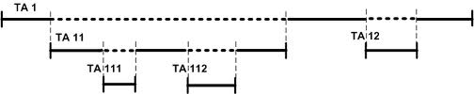
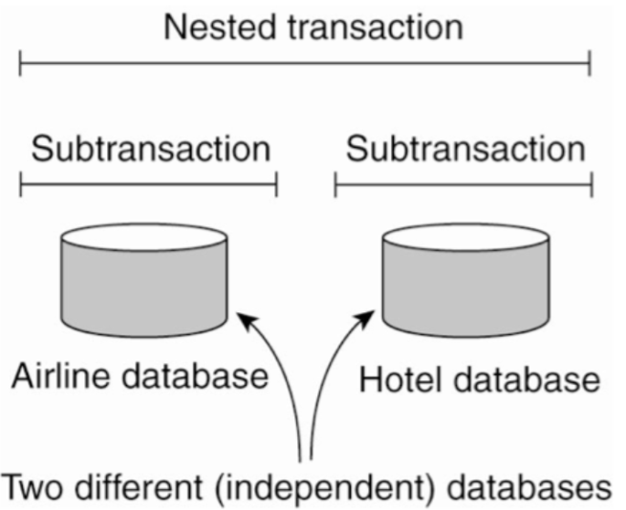
Nested Transactions deal with multiple database
If an enclosing (higher-level) transaction aborts, all its underlying have to be aborted
ACID properties apply to the closed top-level transaction
The top-level transaction may fork off children that run in parallel with one another, on different machines.
Nested transactions are important in distributed systems. They follow a logical division of the work of the original transaction.
Since transactions can be nested arbitrarily deeply, considerable administration is needed.

Slide 66
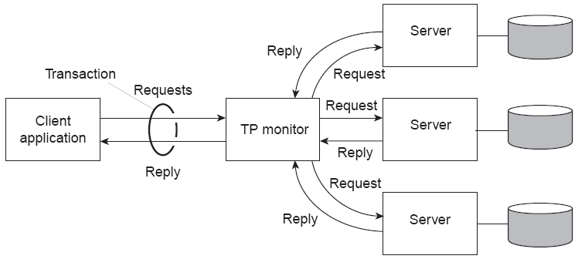
Transaction Processing Monitor (TP monitor)
In many cases, the data involved in a transaction is distributed across several servers.
As the core of OLD enterprise middleware systems, a TP monitor is responsible for coordinating the execution of a transaction.

Slide 67

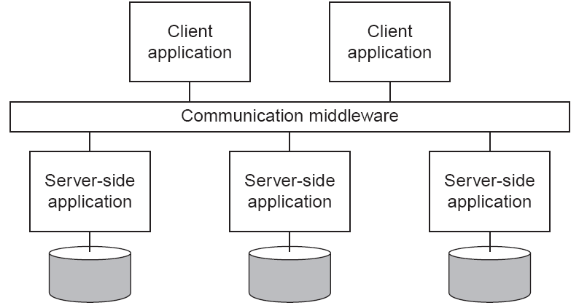
Enterprise Application Integration (EAI)
Application components
should be able to communicate directly with each other
not merely by the request/reply behavior that was supported by TP monitor
Facilities are needed to integrate applications independent from their database
Middleware as a communication facilitator in EAI.
Examples:
- Remote Procedure Calls (RPC)
- Remote Method Invocations (RMI)
- Message-Oriented Middleware (MOM)
(Publish/Subscribe Systems)

Slide 68
How to integrate applications
File transfer: Technically simple, but not flexible:
Figure out file format and layout
Figure out file management
Update propagation, and update notifications.
Shared database: Much more flexible, but still requires common data scheme next to risk of bottleneck.
Remote procedure call (RPC): Effective when execution of a series of actions is needed.
Messaging: RPCs require caller and callee to be up and running at the same time. Messaging allows decoupling in time and space.

Slide 69
Types of Distributed Systems
Cluster computing
Distributed computing systems
For high-performance computing tasks
Grid computing
Transaction processing systems
Distributed information systems
For information processing
Enterprise application integration
Home systems
Distributed pervasive / embedded systems
Electronic health care systems
For pervasiveness
Sensor networks
……

Slide 70
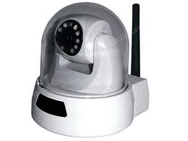
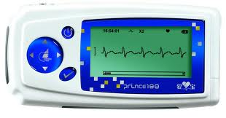

Distributed Pervasive/ubiquitous Systems (1)
Environment’s constraints
Hardware’s constraints
Devices in the system: small, battery-powered, mobile, and having only a wireless connection
e.g., PDA’s, smart phones, sensors, wireless surveillance cameras, portable ECG monitors, etc.
Features:
part of our surroundings and generally lack of human administrative control
“instability” compared to more “traditional” stable distributed systems (fixed nodes and permanent network connection)
Distribution transparency is not really in place in pervasive system.
Distribution of data, processes, and control is inherent to the systems.
It may be better to expose locations here rather than hiding it.
Notes:
Pervasive computing (ubiquitous computing)
Pervasive computing (also called ubiquitous computing) is the growing trend towards embedding microprocessors in everyday objects so they can communicate information. The words pervasive and ubiquitous mean "existing everywhere." Pervasive computing devices are completely connected and constantly available.
Pervasive computing relies on the convergence of wireless technologies, advanced electronics and the Internet. The goal of researchers working in pervasive computing is to create smart products that communicate unobtrusively. The products are connected to the Internet and the data they generate is easily available.
Privacy advocates are concerned about the "big brother is watching you" aspects of pervasive computing, but from a practical standpoint, most researchers feel it will improve efficiency. In a 1996 speech, Rick Belluzo, who was then executive VP and general manager of Hewlett-Packard, compared pervasive computing to electricity. He described it as being "the stage when we take computing for granted. We only notice its absence, rather than its presence."
An example of a practical application of pervasive computing is the replacement of old electric meters with smart meters. In the past, electric meters had to be manually read by a company representative. Smart meters report usage in real-time over the Internet. They will also notify the power company when there is an outage, reset thermostats according to the homeowner's directives, send messages to display units in the home and regulate the water heater.

Slide 71
Distributed Pervasive/ubiquitous Systems (2) -- Definition
Ubiquitous
Accessible from everywhere
Mobile
Which integrates mobile devices
Context-awareness
Which takes into account the execution environment  Pervasive
Which associates ubiquitous, mobility and context-awareness

Slide 72
Distributed Pervasive/ubiquitous Systems (3)
Devices can either be configured by their owners, or need to automatically discover their environment and “nestle in” as best as possible
Emerging next-generation of distributed systems in which nodes are small, mobile, and often embedded in a larger system, characterized by the fact that the system naturally blends into the user’s environment.
Examples: Home Systems, Electronic Health Care Systems, Sensor Networks, etc.
Conclusion: In the presence of mobility, devices should support easy and application-dependent adaption to their local environment.

Slide 73
Distributed Pervasive/ubiquitous Systems (4) -- Properties
Scalability
Invisibility
Transparency for human beings
Minimal intervention of human beings
Adaptation to environment changes
Self-learning
Context-awareness
Perception of changes of the environment
Smartness
Pro-action
Ability to interact, “disturb” the user in order to suggest a better action
To balance with invisibility!➢

Slide 74
Distributed pervasive systems Three (overlapping) subtypes
Ubiquitous computing systems: pervasive and continuously present, i.e., there is a continuous interaction between system and user.
Mobile computing systems: pervasive, but emphasis is on the fact that devices are inherently mobile.
Sensor (and actuator) networks: pervasive, with emphasis on the actual (collaborative) sensing and actuation of the environment.

Slide 75

Ubiquitous systems
Core elements
(Distribution) Devices are networked, distributed, and accessible in a transparent manner
(Interaction) Interaction between users and devices is highly unobtrusive
(Context awareness) The system is aware of a user’s context in order to optimize interaction
(Autonomy) Devices operate autonomously without human intervention, and are thus highly self-managed
(Intelligence) The system as a whole can handle a wide range of dynamic actions and interactions

Slide 76

Mobile computing
Distinctive features
A myriad of different mobile devices (smartphones, tablets, GPS devices, remote controls, active badges.
Mobile implies that a device’s location is expected to change over time ⇒change of local services, reachability, etc
Keyword: discovery.
Communication may become more difficult: no stable route, but also perhaps no guaranteed connectivity ⇒ disruption-tolerant networking.
Notes:
myriad 搜索网络
英 [ˈmɪriəd] 美 [ˈmɪriəd]
IELTS | TOEFL | GRE
adj. 无数的; 多种的，各式各样的;
n. 无数，极大数量; [古语] 一万;
变形 复数: myriads

Slide 77

Mobility patterns
Relationship between information dissemination and human mobility?
Basic idea: an encounter allows for the exchange of information (packet-switched networks)
A successful strategy
Alice’s world consists of friends and strangers.
If Alice wants to get a message to Bob: hand it out to all her friends
Friend passes message to Bob at first encounter
Observation: This strategy works because (apparently) there are relatively closed communities of friends.

Slide 78

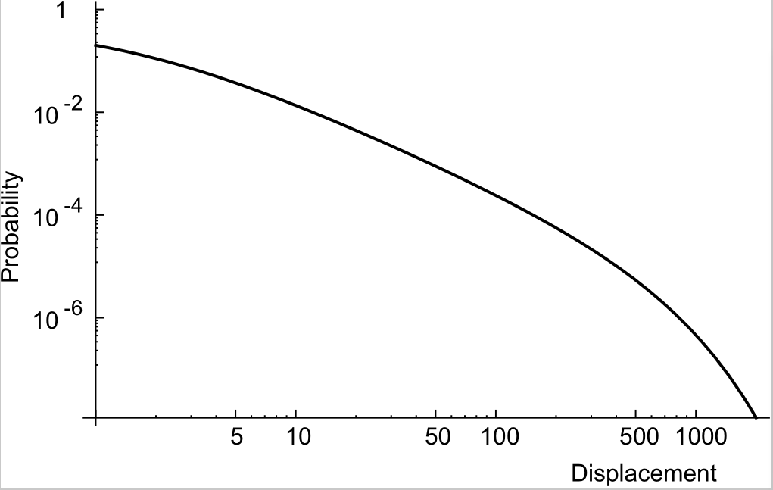
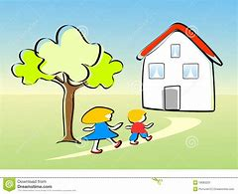
How mobile are people?
Experimental results
Tracing 100,000 cell-phone users during six months leads to:
Moreover: people tend to return to the same place after 24, 48, or 72 hours ⇒ we’re not that mobile.

Slide 79
Sensor networks
Characteristics
The nodes to which sensors are attached are:
Many (10s-1000s)
Simple (small memory/compute/communication capacity)
Often battery-powered (or even battery-less)

Slide 80
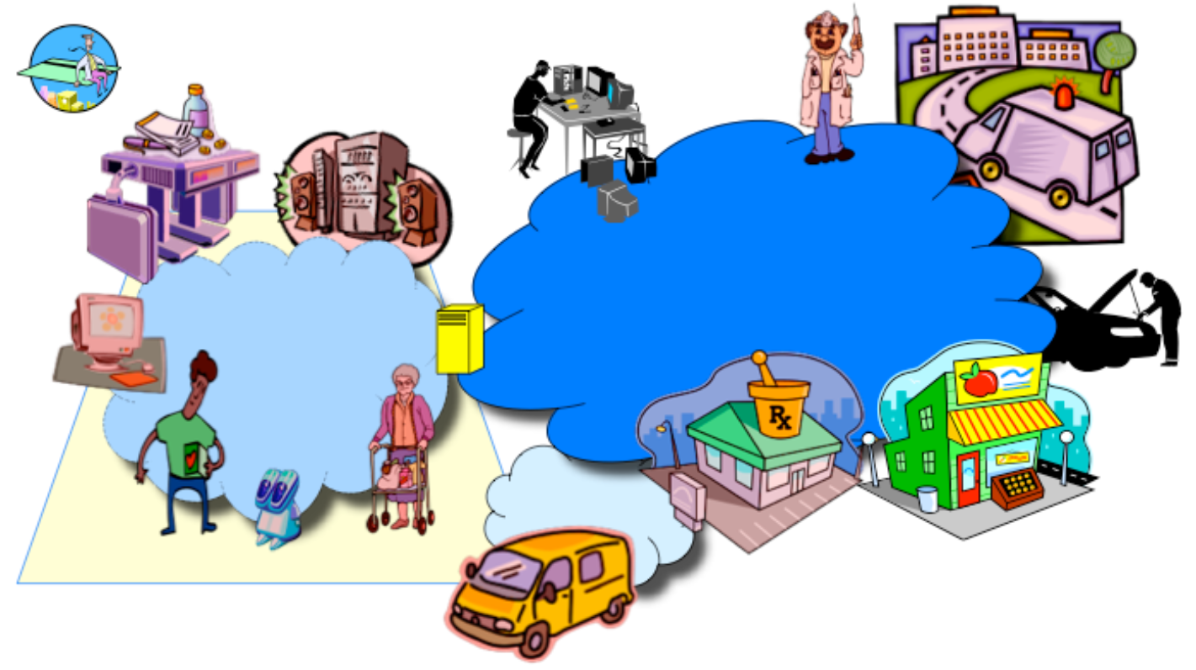
Embedded Home Environment

Slide 81
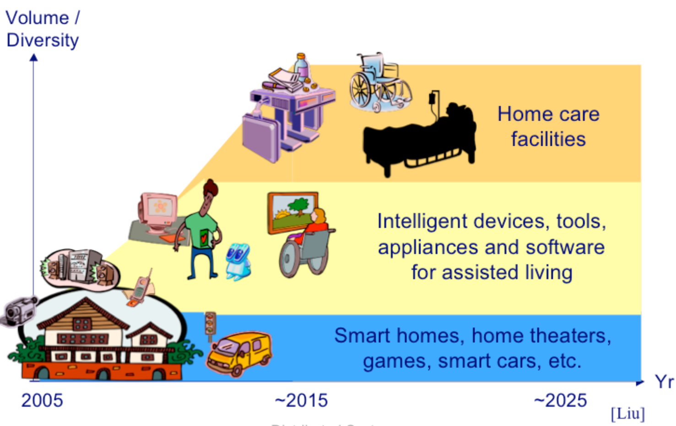
Home and Personal Appliances (2)

Slide 82
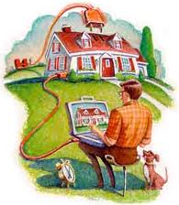
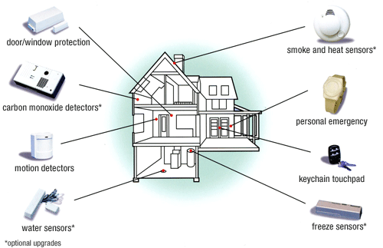

Home Systems
Features:
built around home networks
consist of one or more PCs
typical customer electronics or all home devices are integrated into a single distributed system
UPnP (self-managing)

Slide 83
Motivation
Today
Computers
Internet wired connection
Tomorrow
Every object will be smart (Embedded processors + memory)
Wireless connection (802.11*, Bluetooth, etc. + Internet New Generation, IPv6)

Slide 84
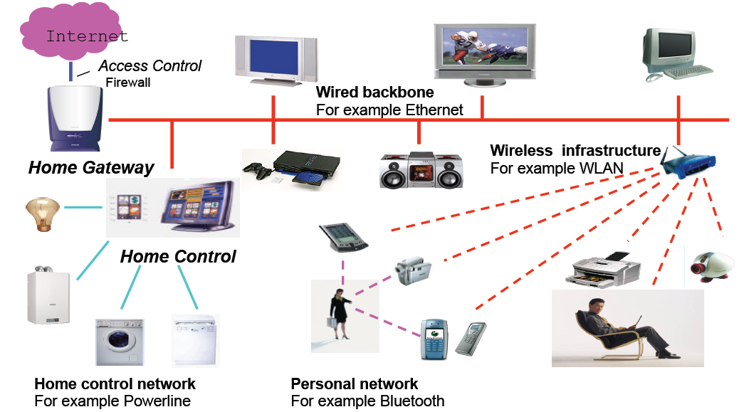
Now: Room with Several Visible Devices

Slide 85
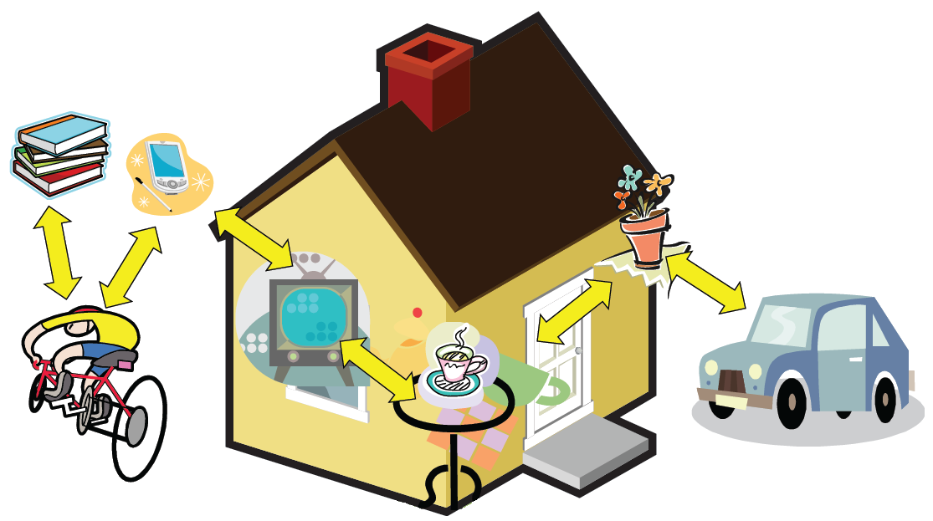
Tomorrow: Everyday life full of invisible appliances

Slide 86
Justification
Rapid advances in component technologies, e.g.,
Smart gadgets, wearable sensors and actuators, robotic helpers, mobile devices
Wireless, wideband interconnects
Increasing critical needs due to
Aging baby-boom generation
Long life expectancy
New safety, security, and privacy concerns

Slide 87
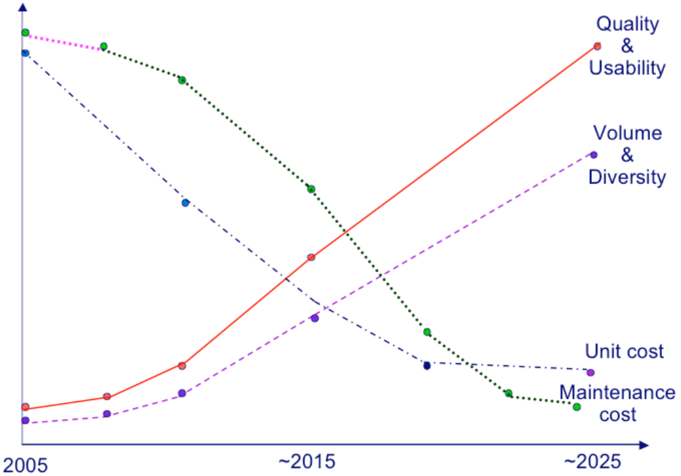
Desired Trends
The environment must be open and evolvable, &
capable of self diagnosis, healing, maintenance

Slide 88
Electronic Health Care Systems (1)
Questions to be addressed for health care systems:
Where and how should monitored data be stored?
How can we prevent loss of crucial data?
What infrastructure is needed to generate and propagate alerts?
How can physicians provide online feedback?
How can extreme robustness of the monitoring system be realized?
What are the security issues and how can the proper policies be enforced?

Slide 89
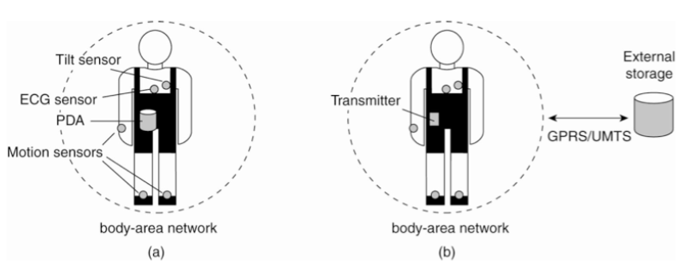

Electronic Health Care Systems (2)
(BAN)
Monitoring a person in a pervasive electronic health care system, using (a) a local hub (part of BAN collecting data as needed)
or (b) a continuous wireless connection to external networks.
For reason of efficiency, devices and BANs need to support in-network data processing (monitoring data must be aggregated before storing and sending).

Slide 90
Sensor Networks: Background
Types of sensors
Seismic, low sampling rate magnetic, thermal, visual, infrared, acoustic and radar
Conditions to monitor
Temperature, humidity, (vehicular) movement, lightning condition, pressure, soil makeup, noise levels
Presence or absence of certain kinds of objects
Mechanical stress levels on attached objects
Current characteristics such as speed, direction, and size of an object

Slide 91

Sensor Networks: Characteristics
Environment
connect to physical environment (large numbers, dense, real-time)
sensor nodes are prone to failures, non-deterministic
wireless communication
massively parallel interfaces (to users and applications)
limited resources: battery, bandwidth, memory, CPU (power management critical)
Network
Topology changes dynamically
sporadic connectivity
new resources entering/leaving
large amounts of redundancy
self-configure/re-configure

Slide 92
Sensor Networks: Applications
Infrastructure security, military applications
Environmental and Habitat monitoring
Health applications
Smart space/home applications
Other commercial applications
Industrial Sensing
Traffic Control, vehicle tracking and detection
Interactive museums

Slide 93

Smart Spaces
Other Applications
Battlefields/Surveillance
Earthquake areas
Environmental Monitoring
Airport security
Emergency Response
Location Services

Slide 94


Sensor Networks
Storing and processing data (a) only at the operator’s site or (b) only at the sensors
Two extremes
Waste network resources and energy
Facilities for in-network data processing is needed.
Discards the aggregation capabilities of sensors

Slide 95
A Way for In-Networking Processing
Forward a query to all nodes along a tree and aggregate the results for the initiator
Difficult questions:
How do we (dynamically) set up an efficient tree in a sensor network?
How does aggregation of results take place? Can it be controlled?
What happens when network links fail?
Partly solved by TinyDB
Disadvantage: Using single-rooted trees (TinyDB) may not be efficient enough when queries can be initiated from different points in the network

Slide 96






Summary
Advantage 1:
Easier to integrate different applications on different
computers into a
single system for resource sharing.
Advantage 2:
When properly designed, distributed systems scale well.
Distributed systems consist of autonomous computers that work together to give the appearance of a single coherent system.
Trade-offs need to be made between achieving various forms of distribution transparency.
Disadvantages:
More complex software, degradation of performance, weaker security.

Slide 97

Challenges of DS
Secure communication over public networks
who sent it, did anyone see it, did anyone change it
Fault-tolerance
Building reliable systems from unreliable components
nodes fail independently; a distributed system can “partly fail”
Replication, caching, naming
Placing data and computation for effective resource sharing, hiding latency, and finding it again once you put it somewhere.
Coordination and shared state
What should the system components do and when should they do it?
Once they’ve all done it, can they all agree on what they did and when?

Slide 98
Topics of Seminar 1
Please give a vivid introduction about
one grid computing project/application:
Grand challenge problems (e.g., GIMPS, financial modeling, protein folding )
PPT Format
What is a grid computing?
Detailed introduction about one application/project
What is cloud computing?
What is the relationship between cloud computing and distributed system? Please compare the similarities and differences between grid computing and cloud computing.
The market of cloud computing

Slide 99

Topics of Seminar 1
What is cloud computing? What is the relationship between cloud computing and distributed system? Please compare the similarities and differences between grid computing and cloud computing.
What does a centralized algorithm look like in a DS? What are the characteristics of decentralized algorithms?
Describe precisely what is meant by a scalable system? We argued that distribution transparency may not be in place for pervasive systems. This statement is not true for all types of transparencies. Give an example.

Slide 100
Topics of Seminar 1 (cont.)
4. Albert-Laszlo Barabasi; Erzsebet Ravasz, Tamas Vicsek, “Deterministic scale-free networks”, Physica A 299 (2001) page 559–564.
5. Culler, D; Estrin, D; Srivastava, M, “Overview of sensor networks”, COMPUTER, 08/2004, Vol. 37-8.

